Slide 2
Absence of Copyright
This slideshow contains photos, diagrams, and information, some of which were attained through internet searches of public websites. The author of this presentation does not own the copyright on this information, so this slideshow is for personal use only—not for sale or profit. Please utilize it to seek the Lord and grow in your knowledge of His Word and ways.

Slide 4
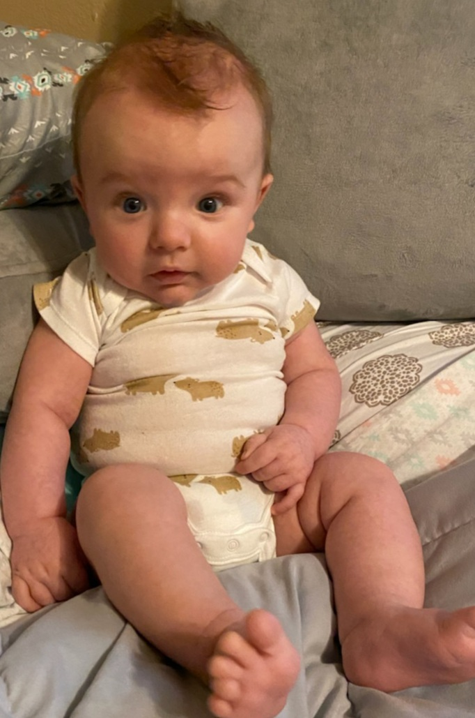
Noah looks ready to hear the rest of Revelation!

Slide 5
Prayer and Announcements
Sunday: 9:15 Fellowship
9:30 SS Master Class
10:30 Worship
Revelation Study available on our church website
www.faithprinceton.org
Email questions and comments to
pastor@faithprinceton.org

Slide 7
END HERE JULY 15, 2020
WEEK 10
BEGIN HERE JULY 22, 2020

Slide 8
Revelation 5:11-12
11 Then I looked, and I heard the voice of many angels around the throne and the living creatures and the elders; and the number of them was myriads of myriads, and thousands of thousands, 12 saying with a loud voice,
“Worthy is the Lamb that was slain to receive power and riches and wisdom and might and honor and glory and blessing.”

Slide 9
Revelation 5:12
“Worthy is the Lamb that was slain to receive...
power (1 Cor. 1:24)
wealth (2 Cor. 8:9; Eph. 3:8)
wisdom (1 Cor. 1:24)
strength (Eph. 6:10; 2 Thess. 1:9)
honour (Heb. 2:9; cf. Phil. 2:11)
glory (John 1:14; Heb. 2:9)
blessing (NIV praise) (Mark 11:9–10; cf. Rom. 15:29)
Notes:
Revelation 5:12 Tyndale
12. Though there is no quotation there are resemblances to the praise of God in 1 Chronicles 29:10–12. Almost all the qualities here are ascribed to Christ elsewhere in the New Testament: power (1 Cor. 1:24), wealth (2 Cor. 8:9; Eph. 3:8), wisdom (1 Cor. 1:24), strength (Eph. 6:10; 2 Thess. 1:9), honour (Heb. 2:9; cf. Phil. 2:11), and glory (John 1:14; Heb. 2:9). ‘Blessing’ (NIV praise) is not specifically used of him, but the corresponding verb is (Mark 11:9–10; cf. Rom. 15:29).

Slide 10
The Lamb is Worthy – Rev 5:12
The Lamb is Worthy... The Lamb is Worthy... The Lamb who was slain... He is worthy.
To receive power... and the riches... and the wisdom... He is worthy.
To receive honor... and the glory... and the blessing.... He is worthy,
The Lamb who was slain.
Notes:
SONG: “The Lamb is Worthy”

Slide 11
Revelation 5:13-14
13 And every created thing which is in heaven and on the earth and under the earth and on the sea, and all things in them, I heard saying,
“To Him who sits on the throne, and to the Lamb, be blessing and honor and glory and dominion forever and ever.”
14 And the four living creatures kept saying, “Amen.” And the elders fell down and worshiped.
Notes:
Revelation 5:13 Tyndale 13. Now the whole creation joins in the song. Every creature is explicit enough, but John spells it out by mentioning specifically heaven, earth, the subterranean regions and the sea. All that is in them is redundant, but it serves to emphasize that all are included in the mighty chorus of praise. John’s vision is not concerned with an obscure being of no great importance. In the last resort there is no creature, wherever found, which does not recognize the superior worth of the Lamb.
-------------------------------------------------------
“Dominion” = κράτος = “might” = : dominion, strength, power; a mighty deed.
κράτος, κρατεος (κράτους) (from a root meaning 'to perfect, complete' (Curtius, § 72); from Homer down), τό, Hebrew עֹז;
1. force, strength.
2. power, might: τό κράτος τῆς ἰσχύος αὐτοῦ, the might of his strength, Ephesians 1:19; Ephesians 6:10; τῆς δόξης αὐτοῦ, Colossians 1:11; κατά κράτος, mightily, with great power, ηὔξανε, Acts 19:20; metonymy, a mighty deed, a work of power: ποιεῖν κράτος (cf. ποιεῖν δυνάμεις), Luke 1:51.
3. dominion: in the doxologies, 1 Timothy 6:16; 1 Peter 4:11; 1 Peter 5:11; Jude 1:25; Revelation 1:6; Revelation 5:13; τίνος (the genitive of object), Hebrews 2:14 (τό Περσεων κράτος ἔχοντα, Herodotus 3, 69). (Synonym: see δύναμις, at the end.)

Slide 12
Revelation 6 Breaking of 1st Six Seals
Compare Matthew 24, Mark 13, and Luke 21
Notes:
The seventh seal gives way to the blowing of the seven trumpets, so some question whether the seals are just preparatory to the actual unfolding of the scroll. (see Newport p. 181) “... The seals represent preliminary events, the things that must take place before the scroll is opened.”
This would bring comfort to a suffering church knowing that “when fearful things happen to them God is not taken by surprise. On the contrary, these victories and hardships are intrinsic parts of God’s redemptive plan. They are necessary precursors of His final victory.”
“At most, the seals are signs of the end, not the end itself.”
“The structure is parallel to Matthew 24:1-35 and Mark 13:1-37. In these passages, the events of the last days fall into three periods: (1) the period of false Christs, wars, famines, pestilences, earthquakes, and death, called ‘the beginning of birth pains’ (Matt. 24:8, NIV); (2) the period of the Great Tribulation (Matt. 24:21); and (3) the period ‘immediately after the distress of those days,’ when the sun, moon, and stars will be affected and Christ will return (Matt. 24:29-30, NIV). This parallel to major parts of Revelation is too striking to be ignored. Thus the seals would correspond to the ‘beginning of birth pain’ in the Olivet discourse. The events are similar to those occurring under the trumpets (8:2 to 11:19) and bowls (15:1 to 16:21), but they should not be confused with those later and more severe judgments.”
Leviticus 26 on curses for disobedience God says He will punish them 7 times over (v. 18, 21, 24, 28)

Slide 13
Revelation 6:1-2 The First Seal—Rider on White Horse
1 Then I saw when the Lamb broke one of the seven seals, and I heard one of the four living creatures saying as with a voice of thunder, “Come.” 2 I looked, and behold, a white horse, and he who sat on it had a bow; and a crown was given to him, and he went out conquering and to conquer.
Conqueror
Notes:
Newport: Victory? = Matthew 24:14 Gospel preached to the end of the world? Morris: says no.... Doesn’t fit with the horror and destruction.
Crown = stephanos = a victor’s crown, not a royal crown (diadema)
White horses are frequently a sign of victory (Jesus will ride one in Rev 19:11-13)
Conqueror!
Leon Morris (Tyndale) notes that the crown was given to him. (emphasizes sovereignty of God... “The conqueror has only what God allows him to have.”)
Bow doesn’t fit with typical roman weapons of warfare... Points to future (Morris)

Slide 14
Revelation 6:3-4 The Second Seal—War
3 When He broke the second seal, I heard the second living creature saying, “Come.” 4 And another, a red horse, went out; and to him who sat on it, it was granted to take peace from the earth, and that men would slay one another; and a great sword was given to him.
Chaos, Anarchy
Notes:
Granted = given
If God removes peace, then men will slay (butcher, slaughter) one another.... The riots over the past few months have demonstrated that...
The first seal implies a conqueror.
The second seal implies general chaos, anarchy, civil war? Men against men. Hand to hand conflict (sword). Face to face.

Slide 15
Revelation 6:5-6 The Third Seal—Famine
5 When He broke the third seal, I heard the third living creature saying, “Come.” I looked, and behold, a black horse; and he who sat on it had a pair of scales in his hand. 6 And I heard something like a voice in the center of the four living creatures saying, “A quart of wheat for a denarius, and three quarts of barley for a denarius; and do not damage the oil and the wine.”
Famine
Notes:
Famine...
A quart of wheat (a daily portion) for “a day’s wages” (NIV)
Do not damage (hurt) the oil and wine:
indicating a class separation for those who could afford such things (luxuries)? Famine separates the haves and have nots even more!
or could it be implying that they are so scarce, they need to be well-cared for?
NLT and other translations: “Do not waste the oil and wine...”
Curses of Leviticus 26: 24 then I will act with hostility toward you, and I will strike you sevenfold for your sins. 25 And I will bring a sword against you to execute the vengeance of the covenant. Though you withdraw into your cities, I will send a pestilence among you, and you will be delivered into the hand of the enemy. 26 When I cut off your supply of bread, ten women will bake your bread in a single oven and dole out your bread by weight, so that you will eat but not be satisfied. 27 But if in spite of all this you do not obey Me, but continue to walk in hostility toward Me, 28 I will act with furious rage against you, and I Myself will punish you sevenfold for your sins. 29 You will eat the flesh of your own sons and daughters

Slide 16
Revelation 6:7-8 The Fourth Seal—Death
7 When the Lamb broke the fourth seal, I heard the voice of the fourth living creature saying, “Come.” 8 I looked, and behold, an ashen horse; and he who sat on it had the name Death; and Hades was following with him. Authority was given to them over a fourth of the earth, to kill with sword and with famine and with pestilence and by the wild beasts of the earth.
Ashen = χλωρός (chlōros) Green, pale green. The color of death. Pale. Ashen.
Notes:
Ashen = χλωρός (chlōros) Green, pale green. The color of death. Pale. Ashen.
1/4th of the earth = currently that would be the death of 1,950,000,000 out of 7,800,000,000 (almost 2 billion people would die)
Compare that to current coronavirus numbers: almost 15 million cases worldwide and 616,990 deaths
1 death in every 3,160 people vs. Rev 6:8 1 death in every 4 people
But still indicating just a partial judgment of the earth (only 1 part of the 4 corners of the earth?)
Ezekiel 14:21 “For this is what the Sovereign Lord says: How much worse will it be when I send against Jerusalem my four dreadful judgments—sword and famine and wild beasts and plague—to kill its men and their animals! 22 Yet there will be some survivors—sons and daughters who will be brought out of it. They will come to you, and when you see their conduct and their actions, you will be consoled regarding the disaster I have brought on Jerusalem—every disaster I have brought on it. 23 You will be consoled when you see their conduct and their actions, for you will know that I have done nothing in it without cause, declares the Sovereign Lord.”

Slide 17
Revelation 6:7-8 The Fourth Seal—Death
1/4th of the earth = currently that would be the death of 1,950,000,000 out of 7,800,000,000 (almost 2 billion people would die)
Compare that to current coronavirus numbers: almost 15 million cases worldwide and 616,990 deaths
1 death in every 3,160 people vs. 1 death in every 4 people
But still indicating just a partial judgment of the earth (only 1 part of the 4 corners of the earth?)
Notes:
Ashen = χλωρός (chlōros) Green, pale green. The color of death. Pale. Ashen.
1/4th of the earth = currently that would be the death of 1,950,000,000 out of 7,800,000,000 (almost 2 billion people would die)
Compare that to current coronavirus numbers: almost 15 million cases worldwide and 616,990 deaths
1 death in every 3,160 people vs. Rev 6:8 1 death in every 4 people
But still indicating just a partial judgment of the earth (only 1 part of the 4 corners of the earth?)
Ezekiel 14:21 “For this is what the Sovereign Lord says: How much worse will it be when I send against Jerusalem my four dreadful judgments—sword and famine and wild beasts and plague—to kill its men and their animals! 22 Yet there will be some survivors—sons and daughters who will be brought out of it. They will come to you, and when you see their conduct and their actions, you will be consoled regarding the disaster I have brought on Jerusalem—every disaster I have brought on it. 23 You will be consoled when you see their conduct and their actions, for you will know that I have done nothing in it without cause, declares the Sovereign Lord.”

Slide 18
Revelation 6:9-11 The Fifth Seal—Martyrs
9 When the Lamb broke the fifth seal, I saw underneath the altar the souls of those who had been slain because of the word of God, and because of the testimony which they had maintained; 10 and they cried out with a loud voice, saying, “How long, O Lord, holy and true, will You refrain from judging and avenging our blood on those who dwell on the earth?”
Notes:
First four seals = events on earth
Fifth seal = transported to heaven...

Slide 19
Revelation 6:9-11 The Fifth Seal—Martyrs
11 And there was given to each of them a white robe; and they were told that they should rest for a little while longer, until the number of their fellow servants and their brethren who were to be killed even as they had been, would be completed also.

Slide 20
Revelation 6:9-11 The Fifth Seal—Martyrs
9 When the Lamb broke the fifth seal, I saw underneath the altar the souls of those who had been slain because of the word of God, and because of the testimony which they had maintained; 10 and they cried out with a loud voice, saying, “How long, O Lord, holy and true, will You refrain from judging and avenging our blood on those who dwell on the earth?”
Martyrs / Testimony = μαρτυρίαν (martyrian)
Notes:
First four seals = events on earth
Fifth seal = transported to heaven...
Verse 9
Martyrs kept at the altar, just as the prayers of the saints are precious as incense before His throne (Rev 5:8; 8:3-4)
Slain = butchered, slaughtered, maimed (same thing that happened to the Lamb) = comfort for a persecuted church that was facing martyrdom – that no matter how violently they died, God would hold them close!
Testimony = μαρτυρίαν (martyrian) from which we get the English word martyr (either the testimony of Jesus that they shared with the world or the testimony of their lives as a witness to the Gospel or both?)
Verse 10
Cried out with a loud voice = screamed, shrieked
How long? = God doesn’t view time as we do... 2 Peter 3:8 But do not let this one fact escape your notice, beloved, that with the Lord one day is like a thousand years, and a thousand years like one day.
O Lord, holy and true = Sovereign Lord, pure and right = they are not commanding action of their Sovereign, but asking when He will stop the injustices of man on the Christian witnesses
Avenging our blood = Romans 12:19 Beloved, never avenge yourselves, but leave it to the wrath of God, for it is written: “Vengeance is mine, I will repay, says the Lord.”
Luke 18: 6 And the Lord said, “Listen to the words of the unjust judge. 7 Will not God bring about justice for His elect who cry out to Him day and night? Will He continue to defer their help? 8 I tell you, He will promptly carry out justice on their behalf. Nevertheless, when the Son of Man comes, will He find faith on earth?”…
Those who dwell on the earth = recurs in Revelation and it seems always to refer to unregenerate mankind as a whole (3:10; 8:13; 11:10; 13:8, 14; 17:8... Similar in 13:12; 17:2) (Morris, Tyndale)

Slide 21
Revelation 6:10
Cried out with a loud voice = screamed, shrieked
How long? = God doesn’t view time as we do...
2 Peter 3:8 But do not let this one fact escape your notice, beloved, that with the Lord one day is like a thousand years, and a thousand years like one day.
O Lord, holy and true = Sovereign Lord, pure and right = they are not commanding action of their Sovereign, but asking when He will stop the injustices of man from being perpetrated upon the Christian witnesses
Notes:
First four seals = events on earth
Fifth seal = transported to heaven...
Verse 9
Martyrs kept at the altar, just as the prayers of the saints are precious as incense before His throne (Rev 5:8; 8:3-4)
Slain = butchered, slaughtered, maimed (same thing that happened to the Lamb) = comfort for a persecuted church that was facing martyrdom – that no matter how violently they died, God would hold them close!
Testimony = μαρτυρίαν (martyrian) from which we get the English word martyr (either the testimony of Jesus that they shared with the world or the testimony of their lives as a witness to the Gospel or both?)
Verse 10
Cried out with a loud voice = screamed, shrieked
How long? = God doesn’t view time as we do... 2 Peter 3:8 But do not let this one fact escape your notice, beloved, that with the Lord one day is like a thousand years, and a thousand years like one day.
O Lord, holy and true = Sovereign Lord, pure and right = they are not commanding action of their Sovereign, but asking when He will stop the injustices of man on the Christian witnesses
Avenging our blood = Romans 12:19 Beloved, never avenge yourselves, but leave it to the wrath of God, for it is written: “Vengeance is mine, I will repay, says the Lord.”
Luke 18: 6 And the Lord said, “Listen to the words of the unjust judge. 7 Will not God bring about justice for His elect who cry out to Him day and night? Will He continue to defer their help? 8 I tell you, He will promptly carry out justice on their behalf. Nevertheless, when the Son of Man comes, will He find faith on earth?”…
Those who dwell on the earth = recurs in Revelation and it seems always to refer to unregenerate mankind as a whole (3:10; 8:13; 11:10; 13:8, 14; 17:8... Similar in 13:12; 17:2) (Morris, Tyndale)

Slide 22
Revelation 6:10
Avenging our blood =
Romans 12:19 Beloved, never avenge yourselves, but leave it to the wrath of God, for it is written: “Vengeance is mine, I will repay, says the Lord.”
Luke 18: 6 And the Lord said, “Listen to the words of the unjust judge. 7 Will not God bring about justice for His elect who cry out to Him day and night? Will He continue to defer their help? 8 I tell you, He will promptly carry out justice on their behalf. Never- theless, when the Son of Man comes, will He find faith on earth?”…
Notes:
First four seals = events on earth
Fifth seal = transported to heaven...
Verse 9
Martyrs kept at the altar, just as the prayers of the saints are precious as incense before His throne (Rev 5:8; 8:3-4)
Slain = butchered, slaughtered, maimed (same thing that happened to the Lamb) = comfort for a persecuted church that was facing martyrdom – that no matter how violently they died, God would hold them close!
Testimony = μαρτυρίαν (martyrian) from which we get the English word martyr (either the testimony of Jesus that they shared with the world or the testimony of their lives as a witness to the Gospel or both?)
Verse 10
Cried out with a loud voice = screamed, shrieked
How long? = God doesn’t view time as we do... 2 Peter 3:8 But do not let this one fact escape your notice, beloved, that with the Lord one day is like a thousand years, and a thousand years like one day.
O Lord, holy and true = Sovereign Lord, pure and right = they are not commanding action of their Sovereign, but asking when He will stop the injustices of man on the Christian witnesses
Avenging our blood = Romans 12:19 Beloved, never avenge yourselves, but leave it to the wrath of God, for it is written: “Vengeance is mine, I will repay, says the Lord.”
Luke 18: 6 And the Lord said, “Listen to the words of the unjust judge. 7 Will not God bring about justice for His elect who cry out to Him day and night? Will He continue to defer their help? 8 I tell you, He will promptly carry out justice on their behalf. Nevertheless, when the Son of Man comes, will He find faith on earth?”…
Those who dwell on the earth = recurs in Revelation and it seems always to refer to unregenerate mankind as a whole (3:10; 8:13; 11:10; 13:8, 14; 17:8... Similar in 13:12; 17:2) (Morris, Tyndale)

Slide 23
Revelation 6:11
11 And there was given to each of them a white robe; and they were told that they should rest for a little while longer, until the number of their fellow servants and their brethren who were to be killed even as they had been, would be completed also.

Slide 24
END HERE JULY 22, 2020
BEGIN HERE JULY 29, 2020
WEEK 11

